Slide 1
Forecasting Government Spending on Corticosteroid Subsidies
in Australia
Fola Wu

Slide 2
Problem Statement
How will government spending on corticosteroid subsidies evolve, and what are the implications for healthcare budgeting and policy planning?
Why This Matters
Accurate forecasts help allocate healthcare funding efficiently, prevent budget overruns, and ensure continued access to essential corticosteroid medications.

Slide 3
Data Summary
Monthly government expenditure on corticosteroid drugs (H02 category)
Pharmaceutical Benefits Scheme (PBS)
July 1991 – June 2008
204 monthly observations
Unit: millions of AUD
Source: Medicare Australia

Slide 4
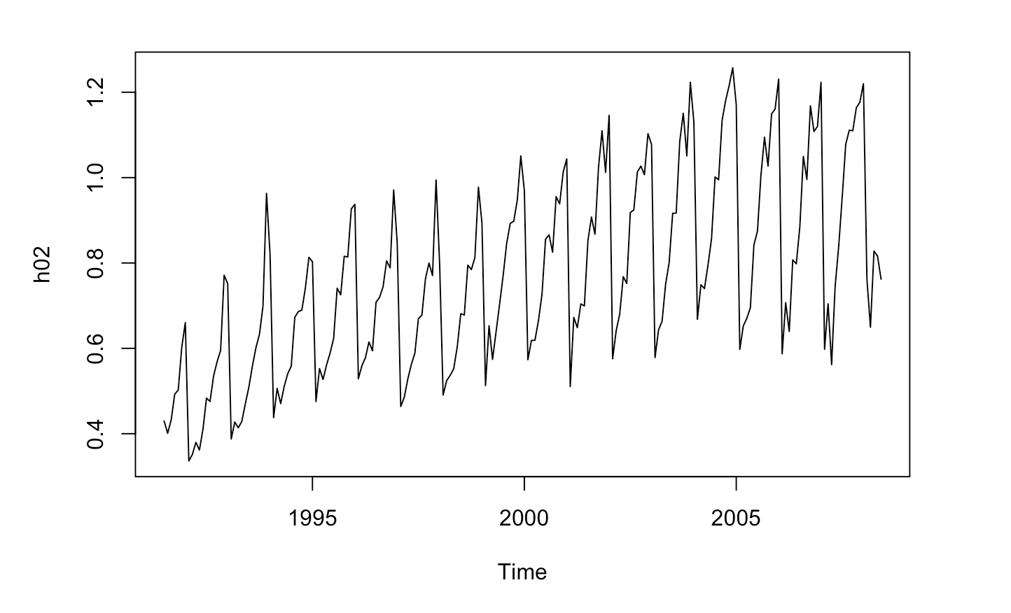
Key Trend Observations
Long-term upward spending trend
Clear seasonal peaks (winter months)
Noticeable acceleration after 2002
Occasional policy-related shifts

Slide 5
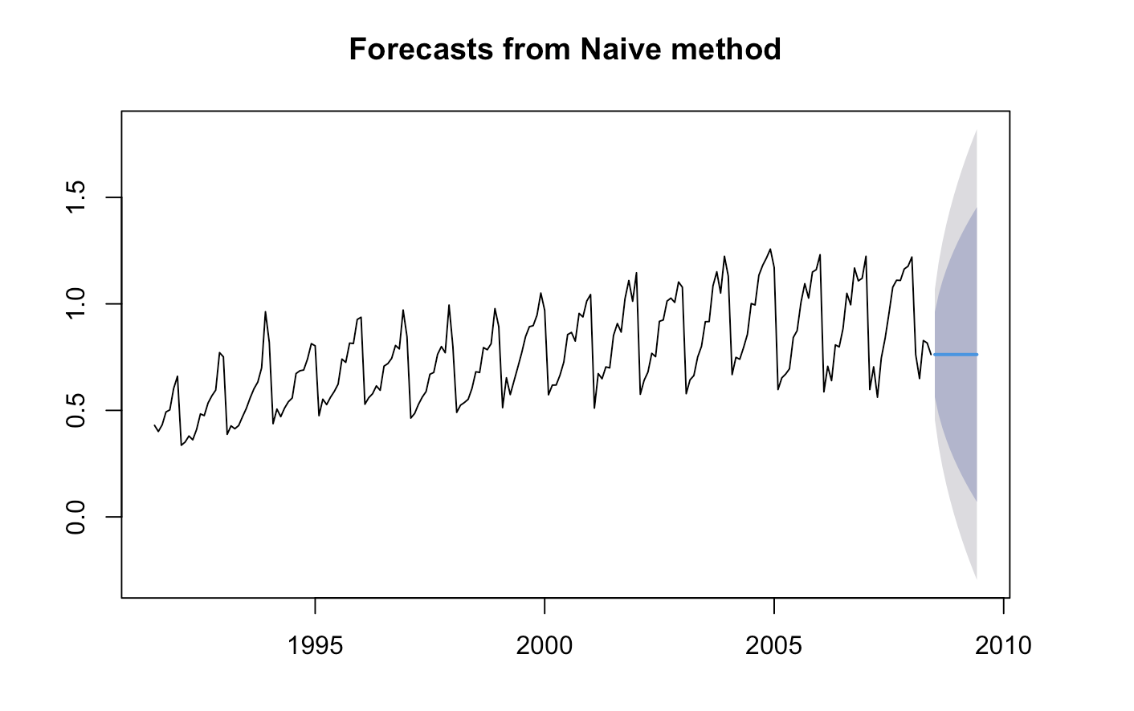
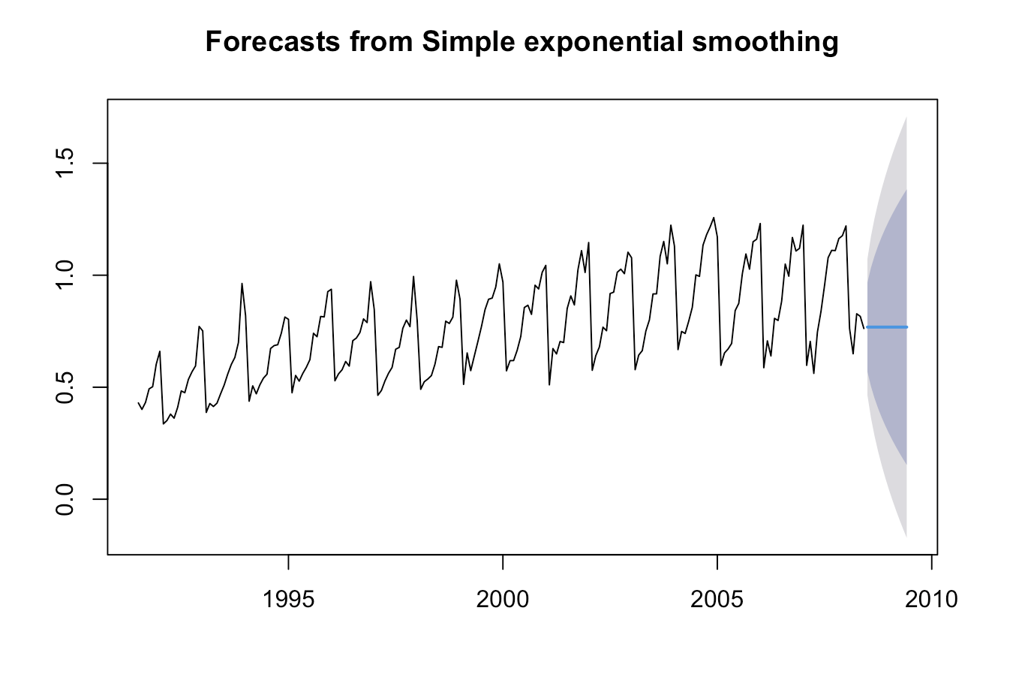
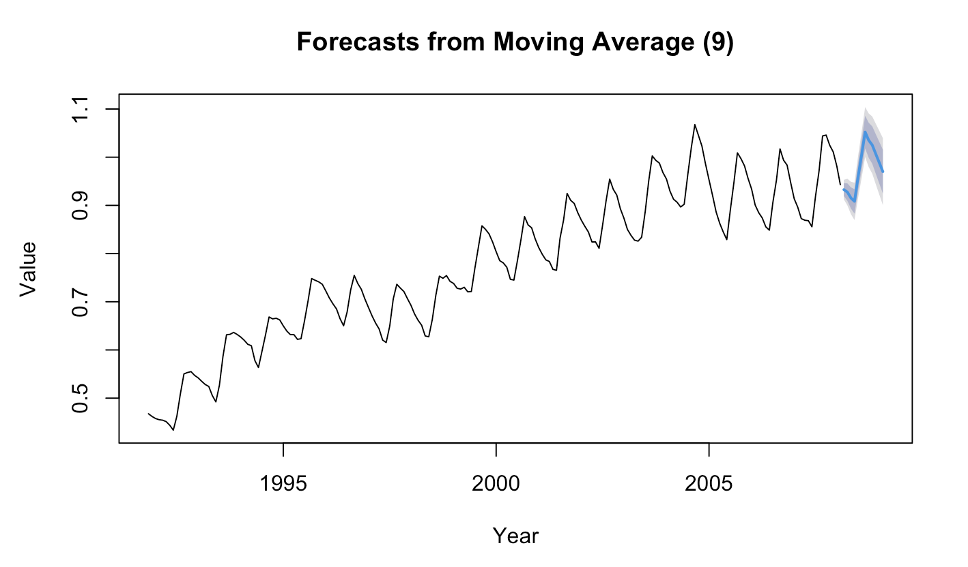
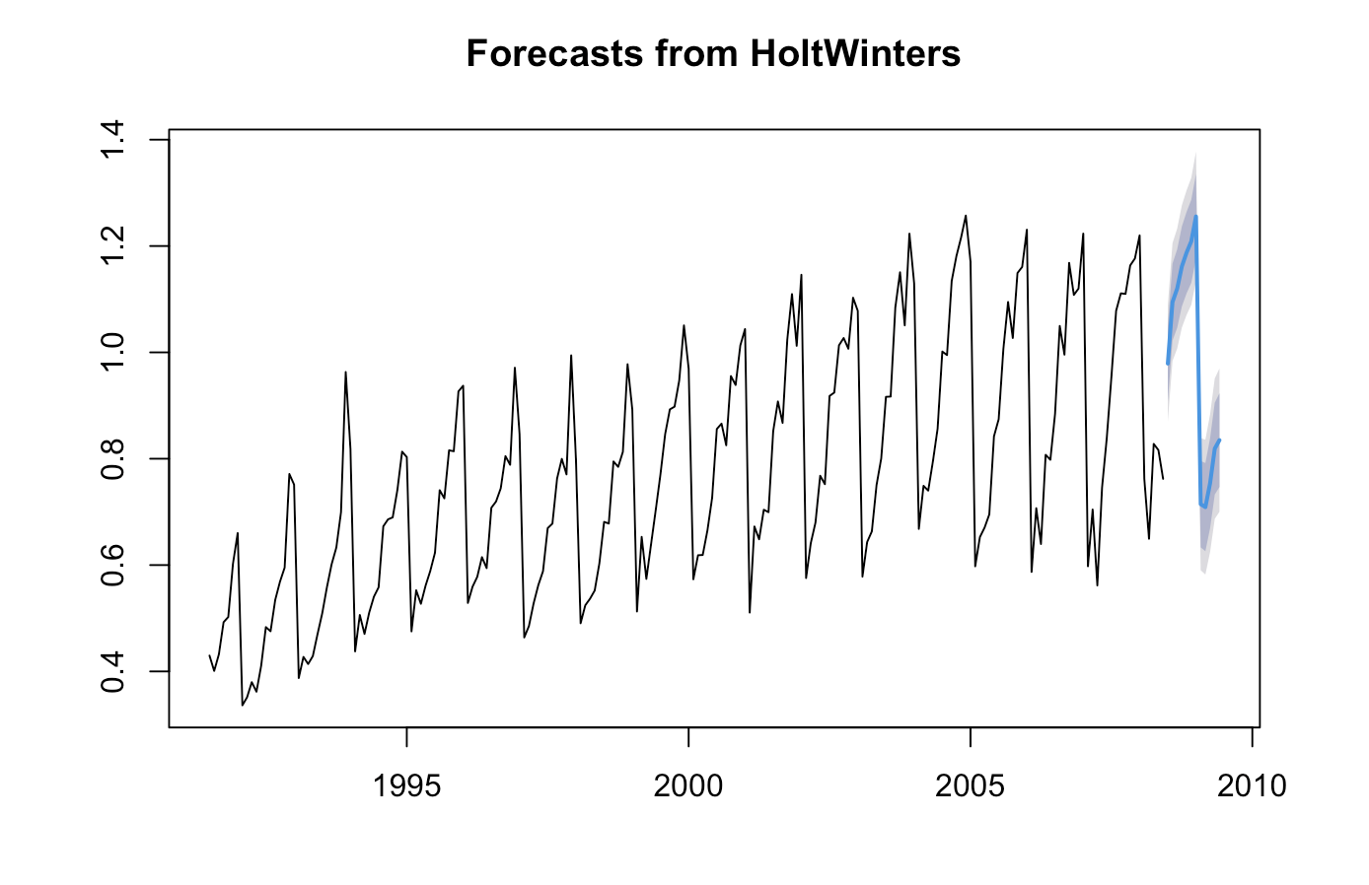
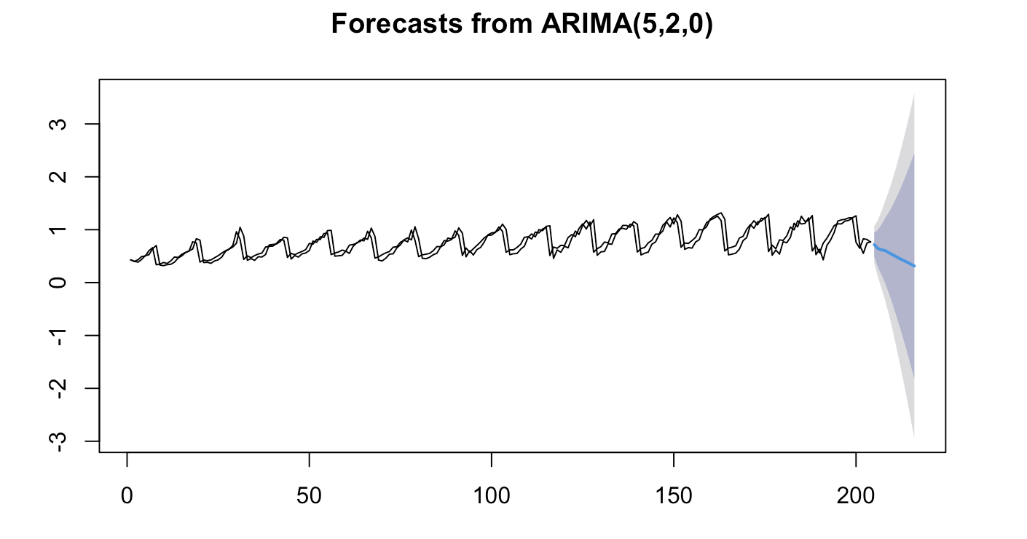
Models Evaluated

Slide 6
Model Comparison Summary
 | ME | RMSE | MAE | MPE | MAPE | MASE | ACF1
Naive | 0.0016 | 0.1558 | 0.0978 | -2.2240 | 14.6856 | 1.6140 | -0.1028
MA9 | -0.0015 | 0.0099 | 0.0078 | -0.2061 | 1.0524 | 0.1874 | 0.4521
SES | 0.0019 | 0.1545 | 0.0951 | -2.4058 | 14.2212 | 1.5683 | 0.0071
HW | -0.0051 | 0.0556 | 0.0421 | -1.3386 | 5.5228 | 0.6938 | -0.0482
ARIMA | -0.0005 | 0.1757 | 0.1173 | -1.6799 | 17.7633 | 1.1994 | -0.0185

Slide 7
Why Selected Holt-Winter
Captures both trend and strong seasonal patterns
Produces realistic forward forecasts
More suitable for budgeting and policy planning
More stable than ARIMA and avoids forecast flattening seen in MA models
 | ME | RMSE | MAE | MPE | MAPE | MASE | ACF1
MA9 | -0.0015 | 0.0099 | 0.0078 | -0.2061 | 1.0524 | 0.1874 | 0.4521
HW | -0.0051 | 0.0556 | 0.0421 | -1.3386 | 5.5228 | 0.6938 | -0.0482

Slide 8
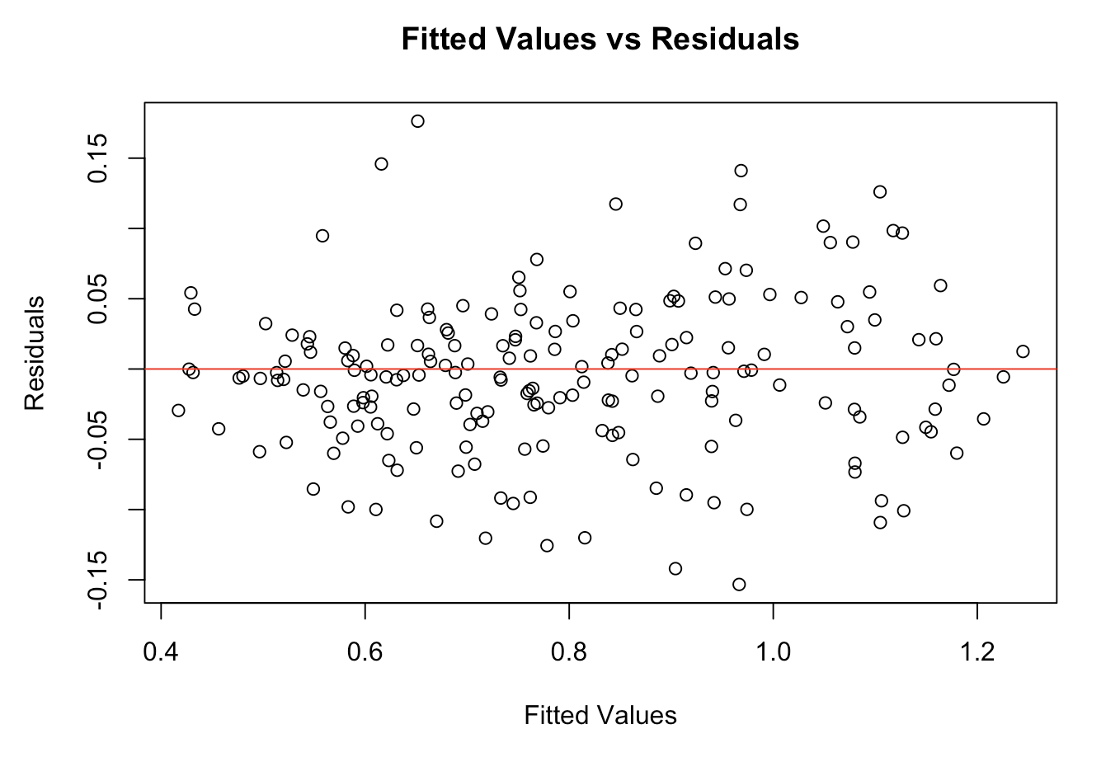
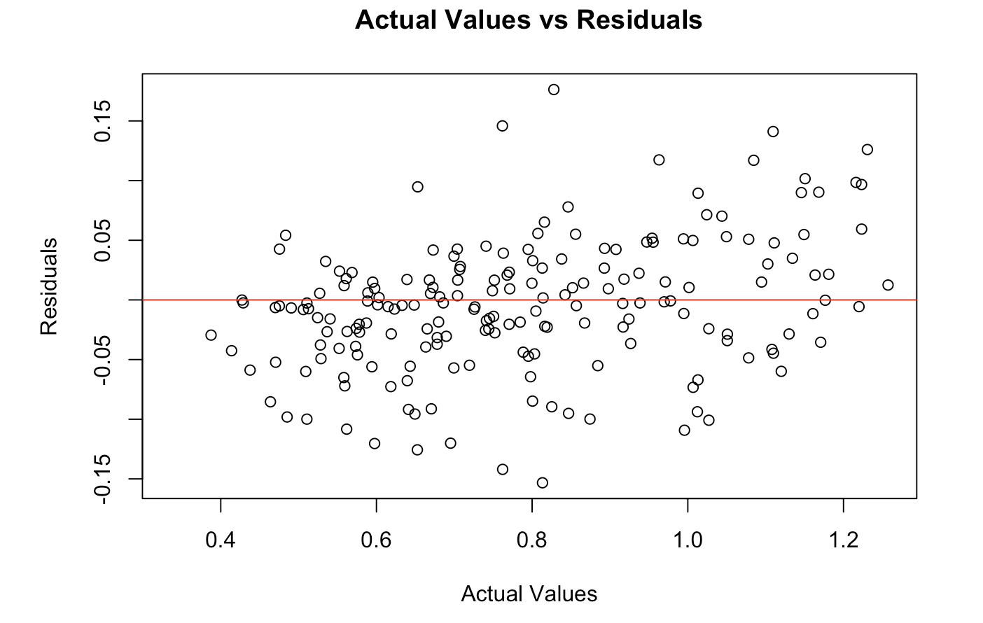
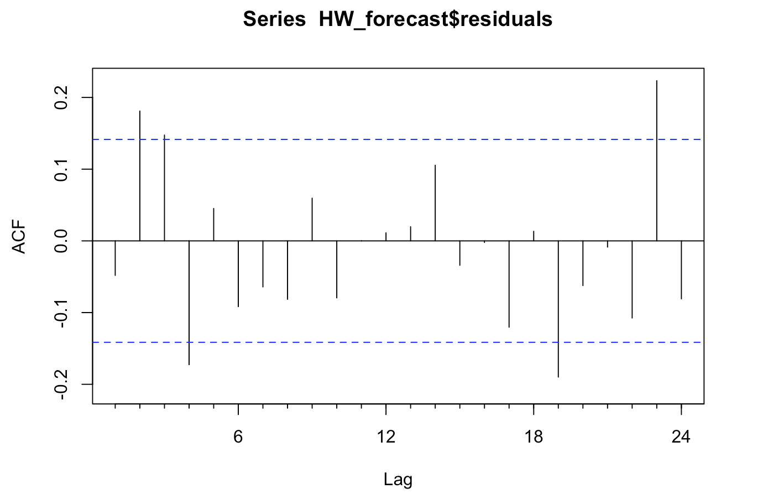
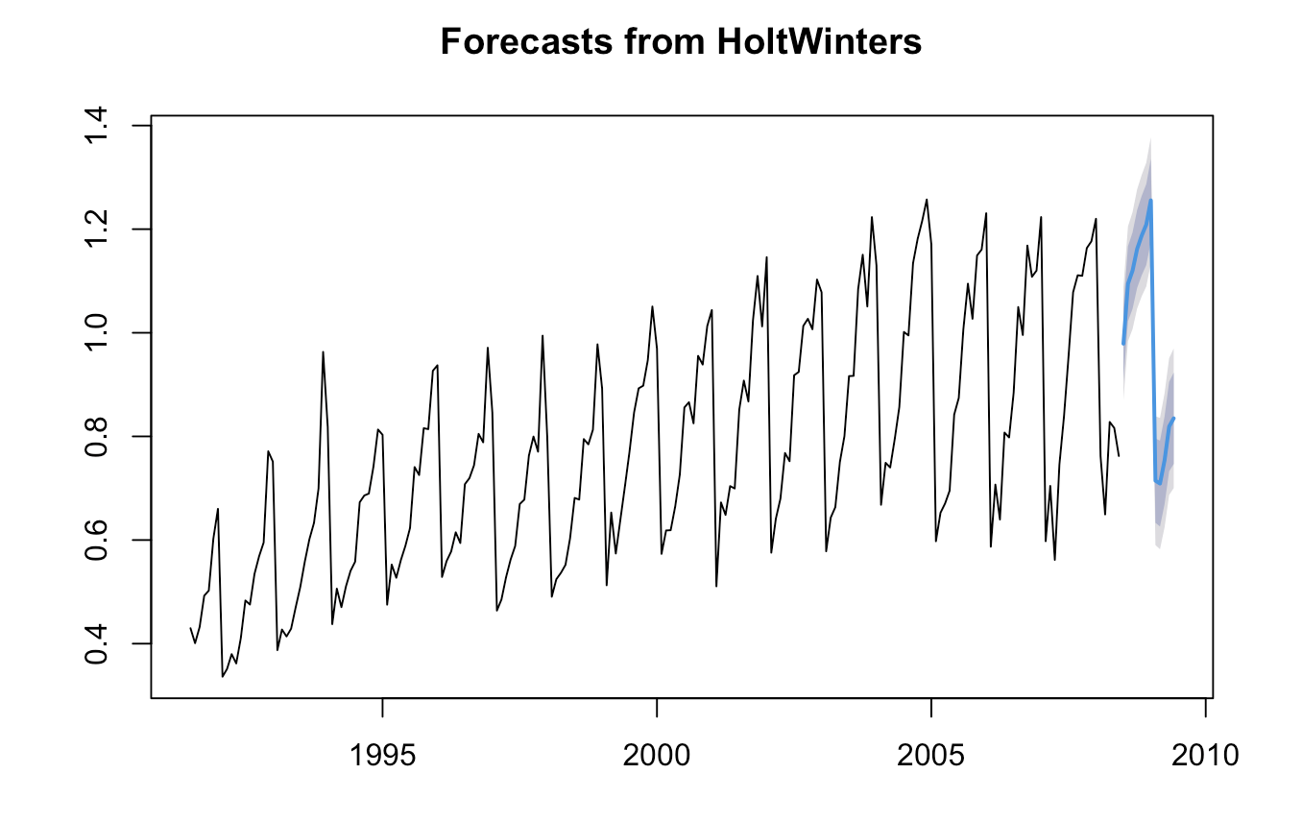
Forecast Results

Slide 9
Recommendations
Increase budget allocation for projected spending growth
Review pricing and reimbursement policies for corticosteroid products
Monitor monthly spending to detect cost or policy-driven shifts early

Slide 10
Conclusion
Spending shows a rising trend with strong seasonal patterns
Holt–Winters provides the most realistic forward forecast
Increasing budget pressure highlights the need for proactive planning

Slide 11
THANKS
Any questions?

